Slide 1
2. Layout your organization, groups, and directories
Enterprise Directory
Adobe Organization
All Users
Adobe Users

Slide 2
2. Layout your organization, groups, and directories, continued
Enterprise Directory
Adobe Organization A
All Users
Domain a
Adobe Users A
Domain access
Org B to Domain a
(optional – allows org B to give licenses to users in a)
Adobe Organization B
Adobe Users B
Domain b

Slide 3
2. Layout your organization, groups, and directories, continued
Enterprise Directory
Adobe Organization A
All Users
Domain a
Adobe Users A
Enterprise Directory
Adobe Organization B
All Users
Domain b
Adobe Users B

Slide 4
2. Layout your organization, groups, and directories, continued
Enterprise Directory
Adobe Organization A
All Users
Adobe Users A
Users
PC or UG A
Enterprise Directory
PC or UG B
All Users
Adobe Users B

Slide 5
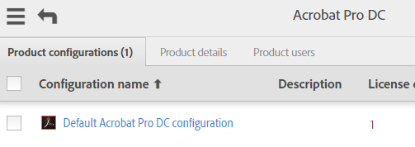
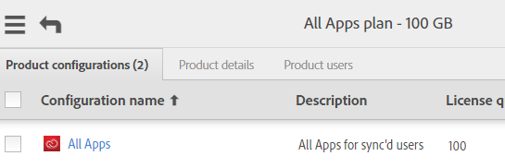
8. Setup config files – Group Map, cont.
Directory Side
Adobe Side
Enterprise Directory
Groups
acrobat_pro_dc
all_apps
Users

Slide 6
8. Setup config files – Group Map, cont.
Customer Side
Adobe Side
Enterprise Directory
Groups
acrobat_pro_dc
all_apps
Users
groups:
- directory_group: acrobat_pro_dc
dashboard_groups:
- Default Acrobat Pro DC configuration
- directory_group: all_apps
dashboard_groups:
- All Apps
Map is to PLC name, not product name
Can map to more than one dashboard group/PLC
--process-groups required

Slide 7
4. Decide how you will handle account deletion, continued
Domain access
Org B to Domain a
(optional – allows org B to give licenses to users in a)
Adobe Organization B
Adobe Organization A
Domain b
Domain a
Org B can delete U1, but if it deletes U2, this results in removing U2 from B but leaving it in org A as is.
U1@b.com
U2@a.com

